Slide 1
Deep Learning Project
Harold Gamarro
Joe Brian Malubay
Said Mejia
Juan Pablo Montoya

Slide 2
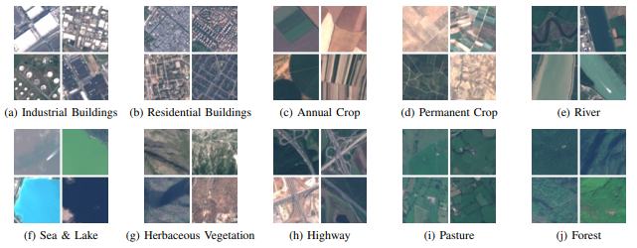
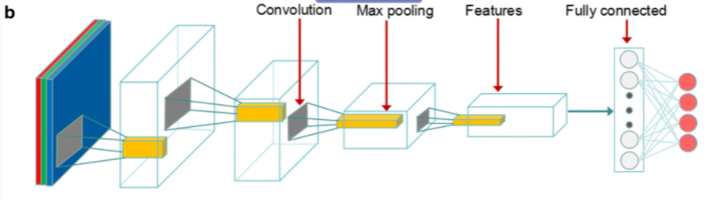
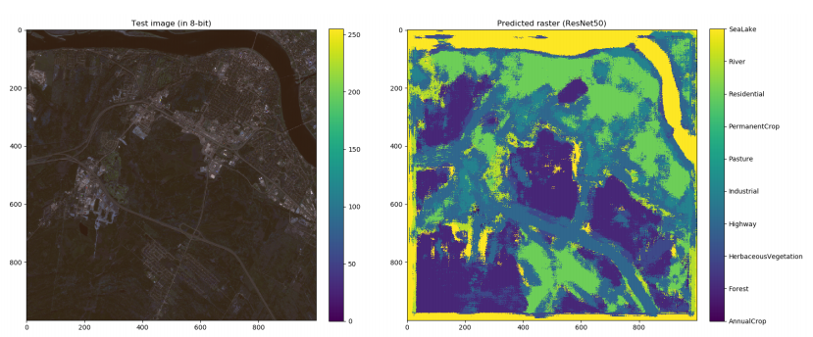
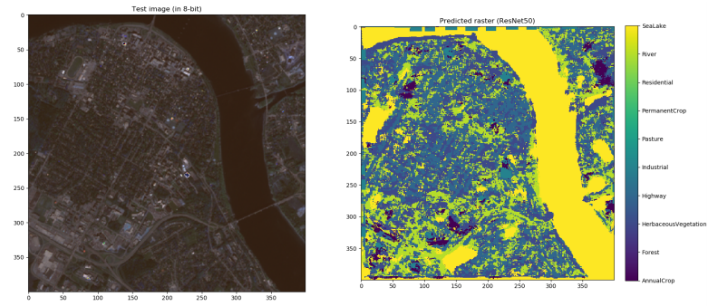
First Approach
It uses REsNet50 and they test it using an experimental image
REsNet50 architecture
Source: EuroSAT: A Novel Dataset and Deep Learning Benchmark for Land Use and Land Cover Classification
Source: LandUse / LandCover Classification using ResNet50

Slide 3
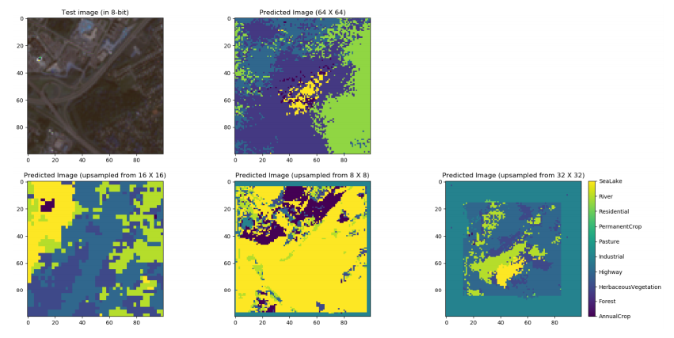
Problems

Slide 4
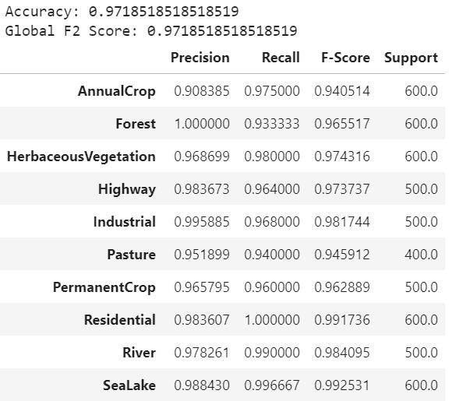
ResNet50 Results

Slide 5
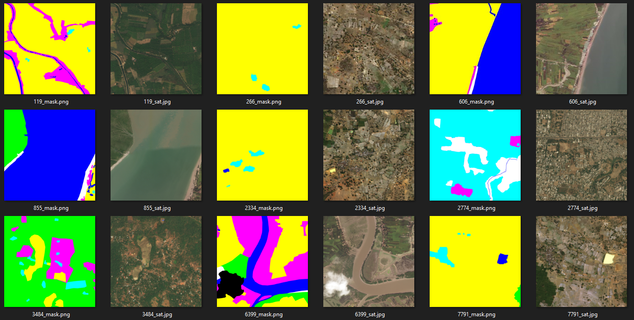
2nd Dataset

Slide 6
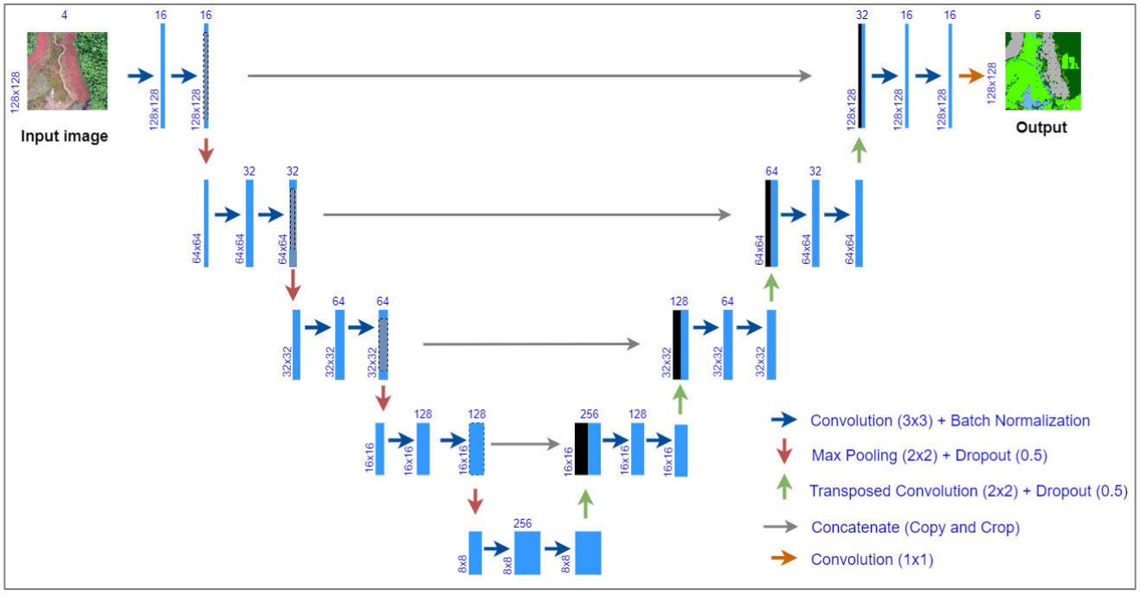
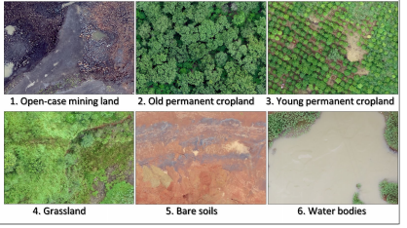
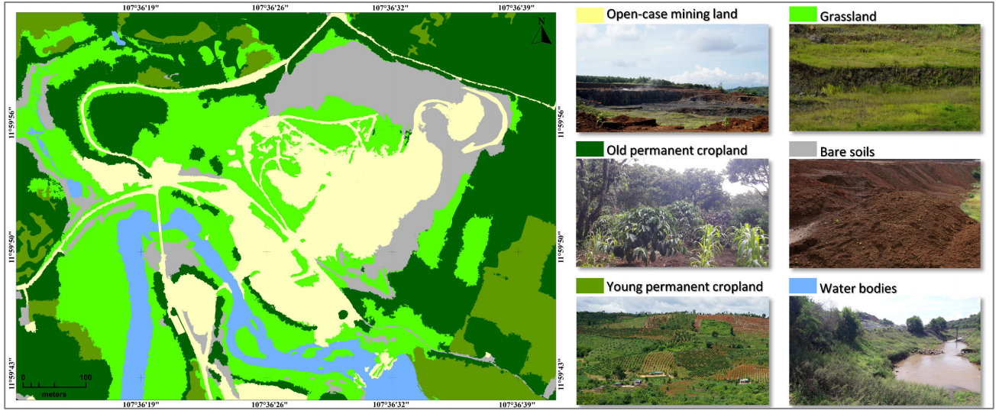
Second Approach U-Net
Image shape: 128x128x4
Source: U-Net Convolutional Networks for Mining Land Cover Classification Based on High-Resolution UAV Imagery

Slide 7
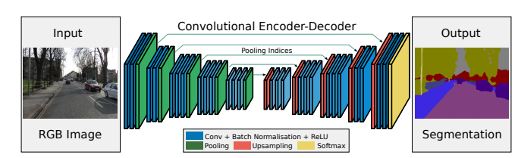
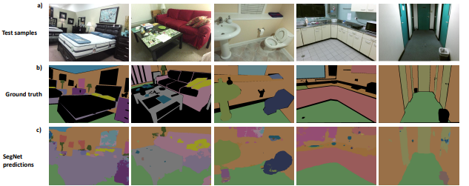
Third Approach SegNet
Source: SegNet: A Deep Convolutional Encoder-Decoder Architecture for Image Segmentation

Slide 8
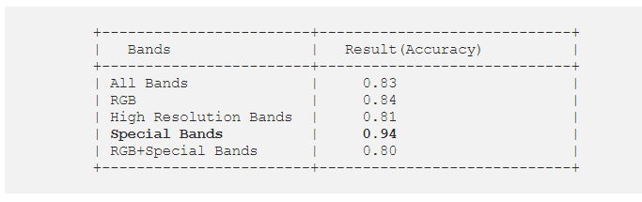
Comments
Develop the each of the 3 approachs
Use second approach using the first dataset from EuroSAT with 12 bands and make some modifications to the number of layers

Slide 9
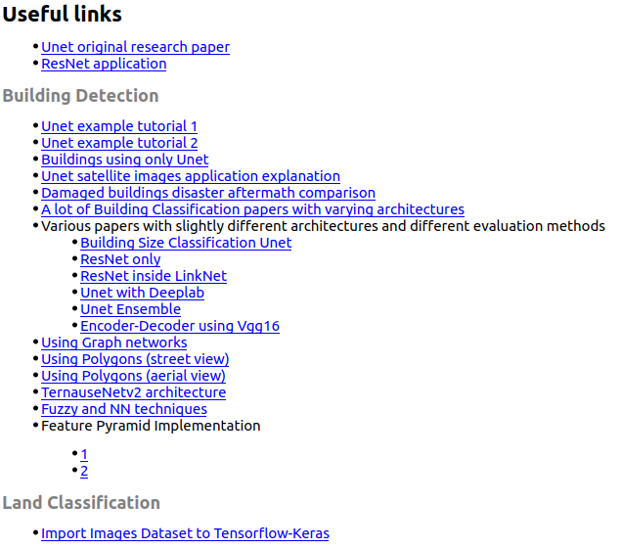
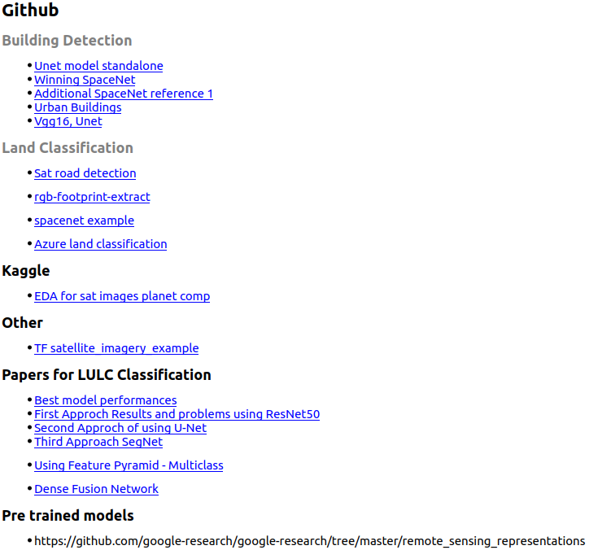

Slide 10
